Slide 1

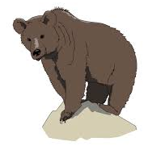
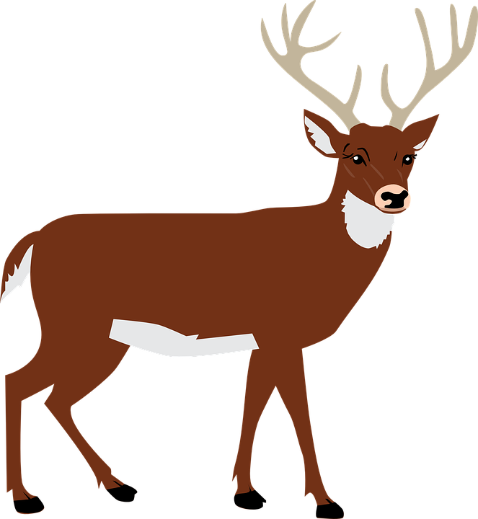



National Park Biodiversity
Project 2
Cameron Kilpatrick, Jacob Stegal, Yash Patel, & Yuli Likhonina
Notes:
*YULI

Slide 2
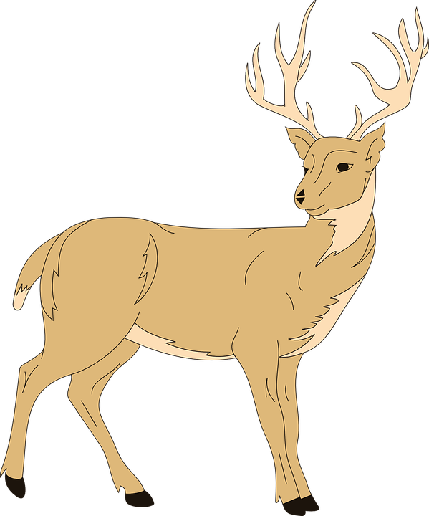

Overview
Motivation:
We love our animal and plant friends!
Purpose:
Discover leading animal and plant species across national parks in the United States
Overall Data Question:
What are the most common types of animals and plant species that are typically found across national parks?
Notes:
*YULI

Slide 3
Data Set Exploration
What are the largest national parks in the country?
Which national parks by state have the most biodiversity?
What are the leading plant and animal species by national park?
What are the leading plant and animal species in the country?
Which plant and animal species are currently endangered?
Notes:
*YULI

Slide 4
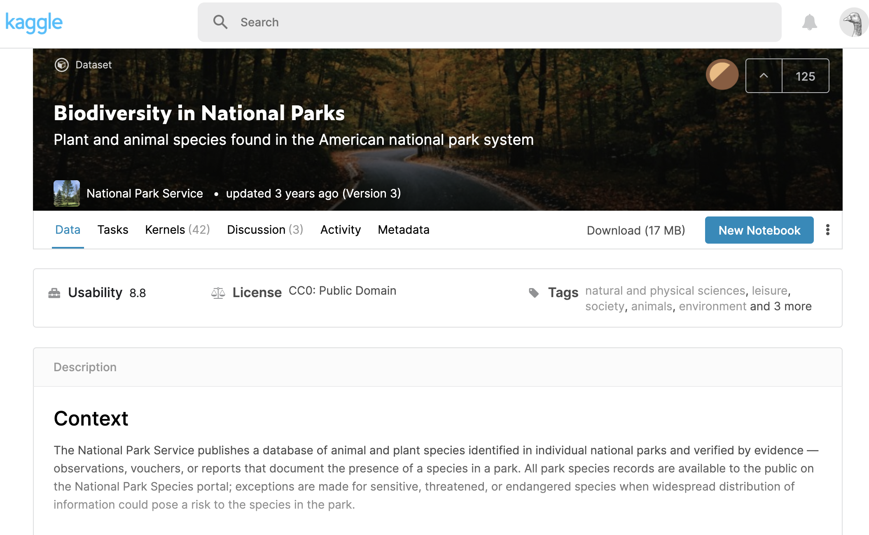
Data Source
Notes:
*CAM

Slide 5
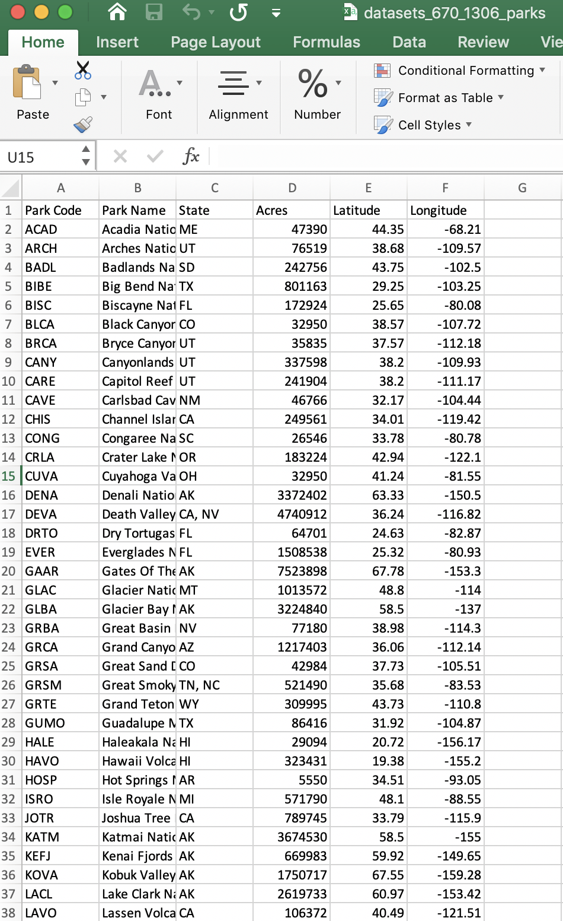
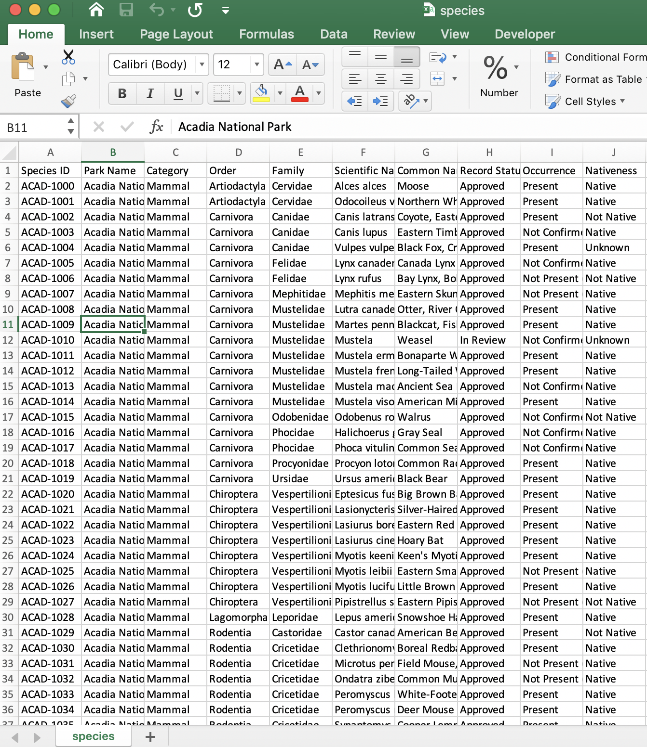
Data Extraction
Notes:
*CAM

Slide 6
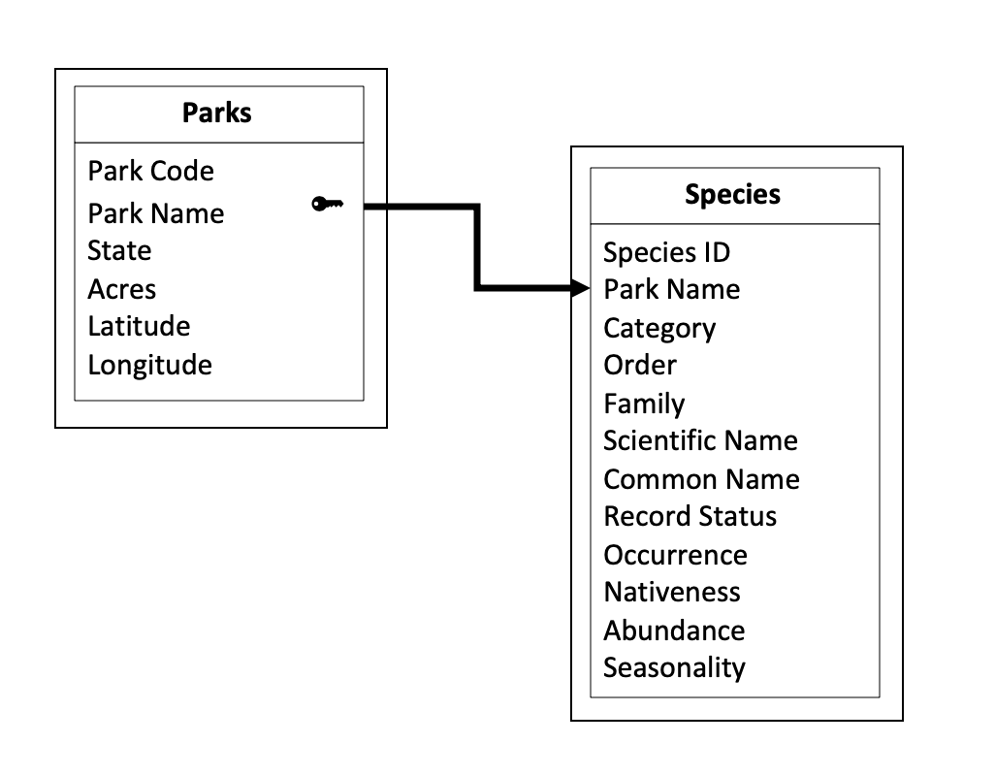
Data Model
Notes:
*CAM

Slide 7

Data Transformation 1
Notes:
*CAM

Slide 8

Data Transformation 2
Notes:
*CAM

Slide 9

Data Transformation 3
Notes:
*CAM

Slide 10

Database Load 1
Notes:
*CAM

Slide 11
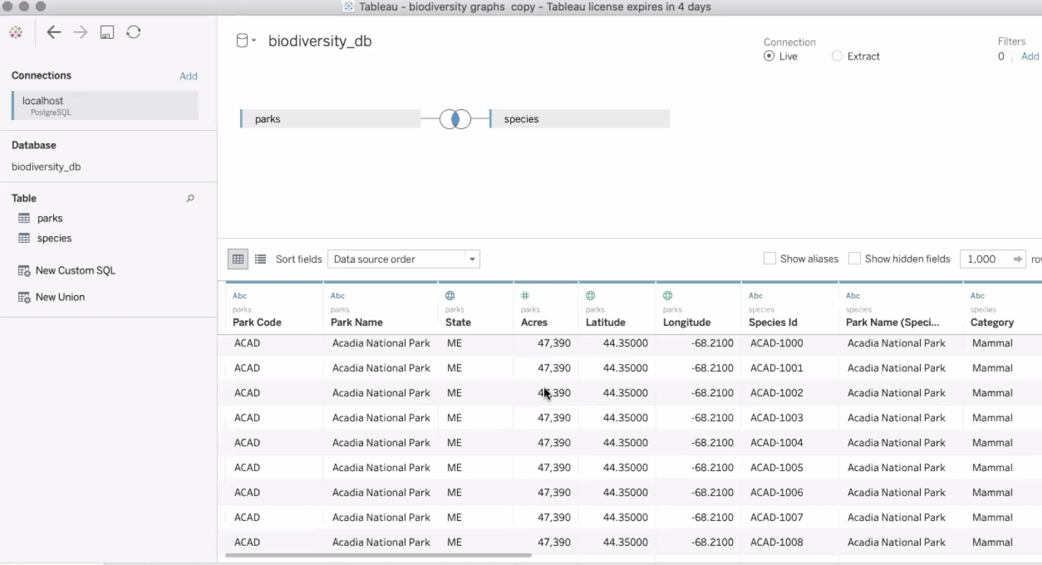
Database Load 2
Notes:
*CAM

Slide 12
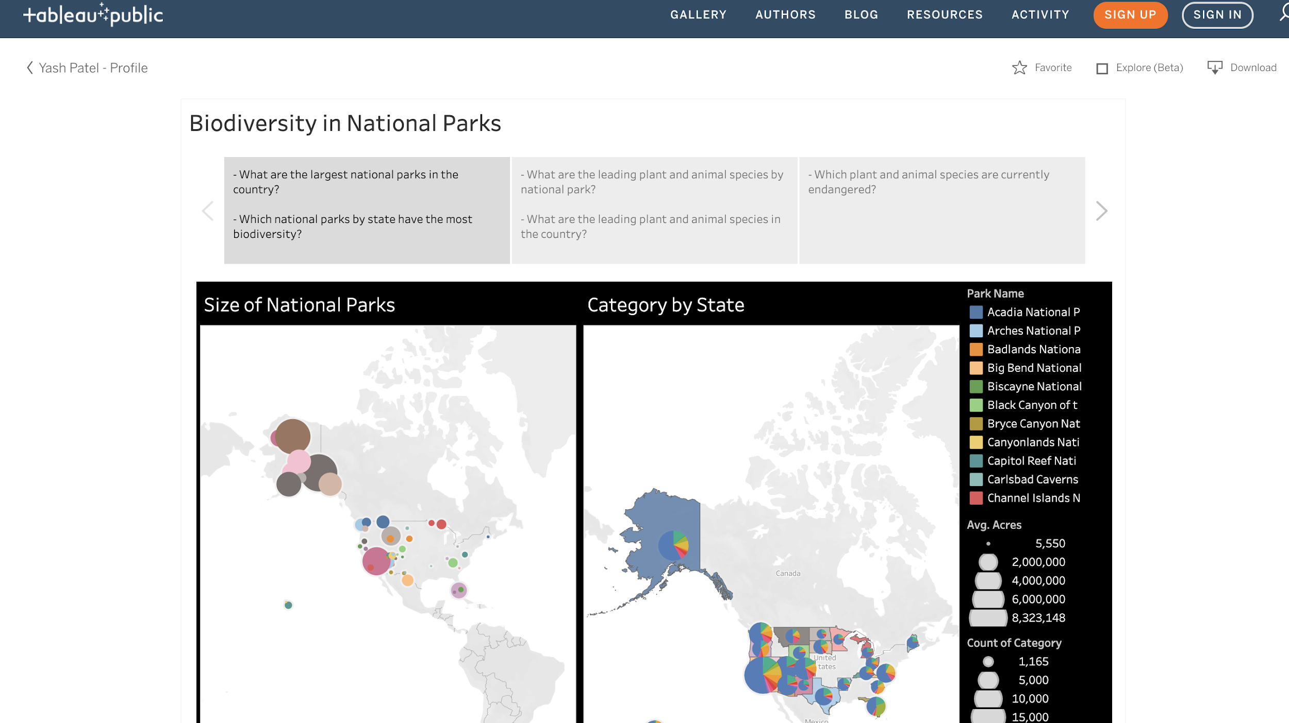
Storyboard
Notes:
*CAM

Slide 13
National Park Biodiversity Conclusions
What are the largest national parks in the country?
Wrangell - Alaska
Gates of Arctic - Alaska
Death Valley - California
Which national parks by state have the most biodiversity?
Alaska
Washington
California
What are the leading plant and animal species by national park?
Vascular Plants
Birds
Insects
Mammals
What are the leading plant and animal species in the country?
Vascular Plants - 65,221
Insects - 14,349
Birds - 14,601
Which plant and animal species are currently endangered?
Black Footed Ferret
Gray Wolf
Pricklyapple Cactus
Notes:
1 - YULI
2 - YULI
3 - YASH
4 - YASH
5 - JACOB

Slide 14

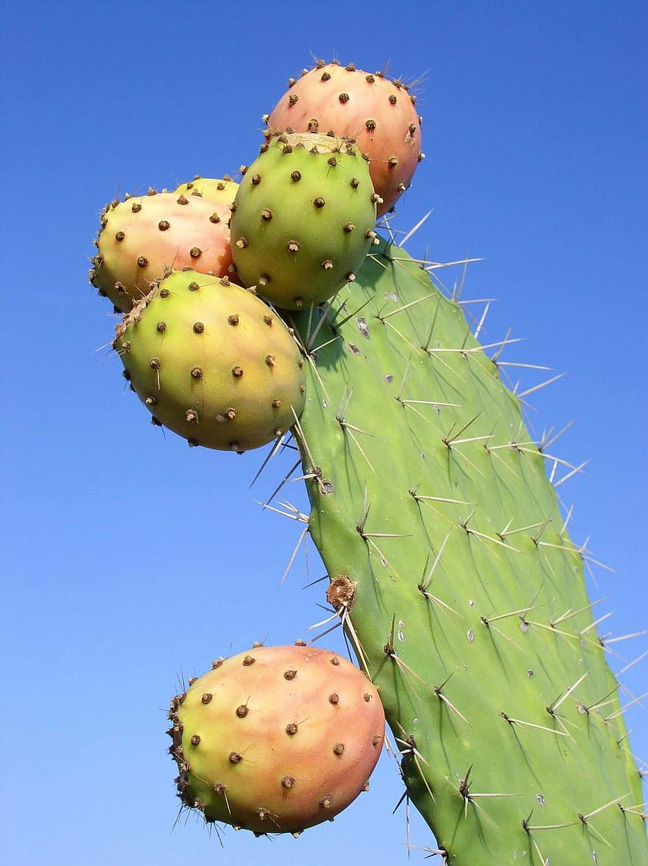
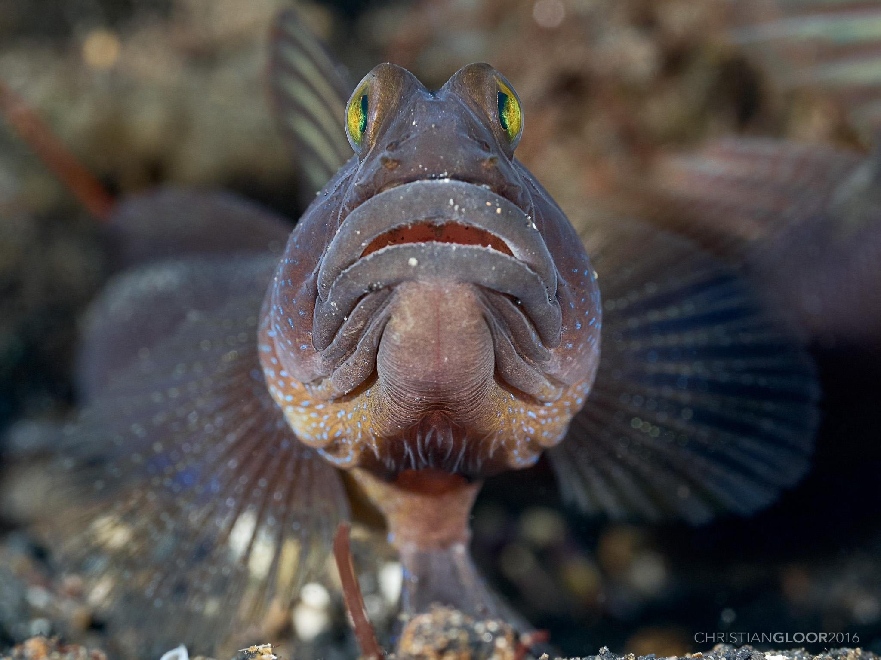
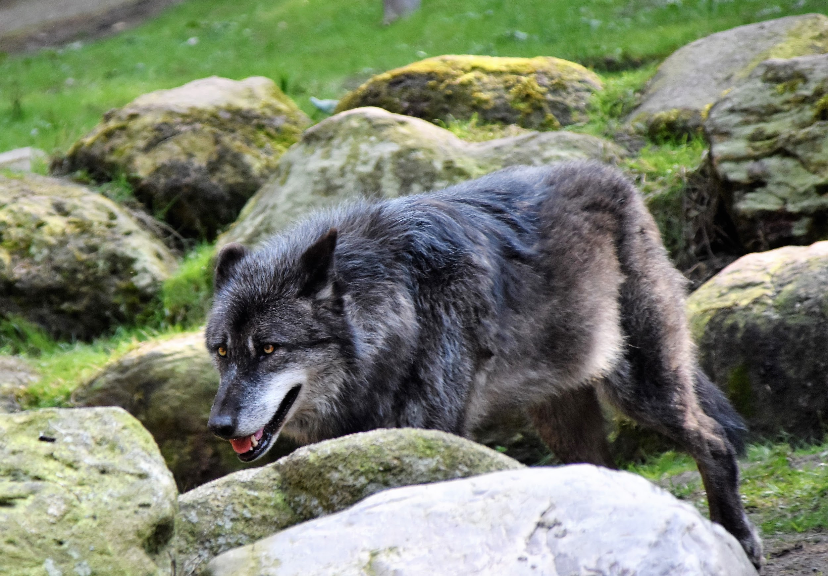
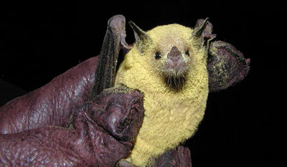
Endangered Species
Notes:
*JACOB
Black Footed Ferret
Gray Wolf
Pricklyapple Cactus
Goby Fish
Long Nosed Bat

Slide 15
Q&A
Notes:
*JACOB

